Slide 1
Test cases
https://www.django-rest-framework.org/api-guide/testing/

Slide 2
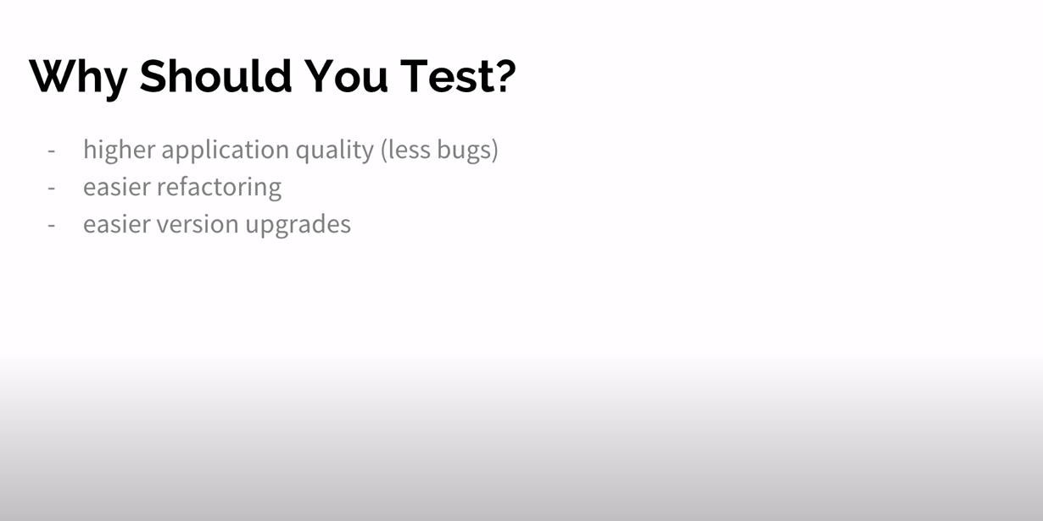

Slide 3
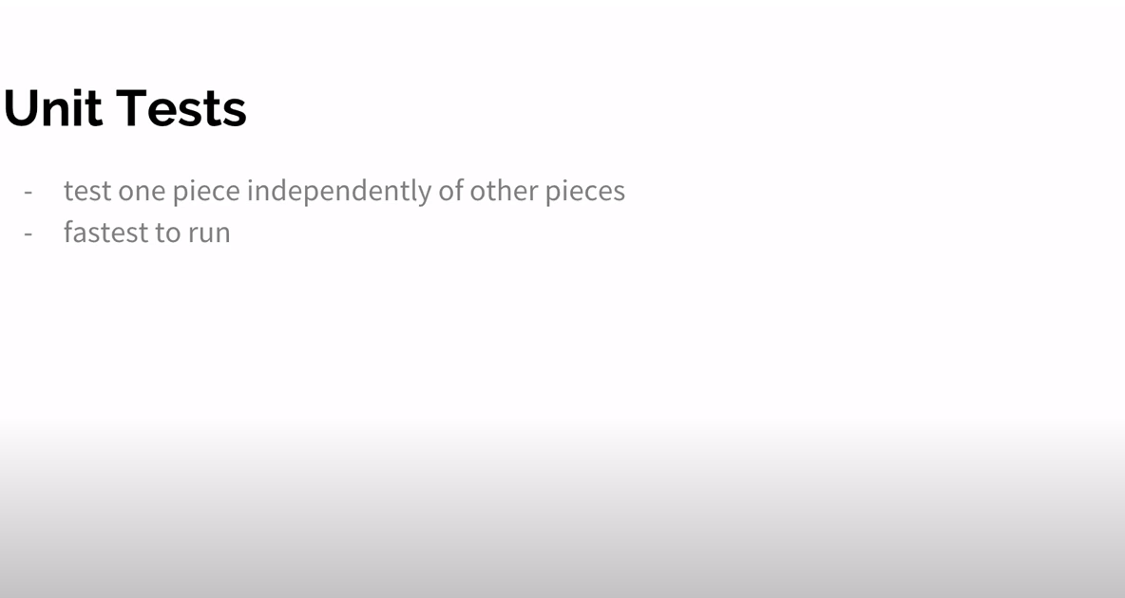

Slide 4
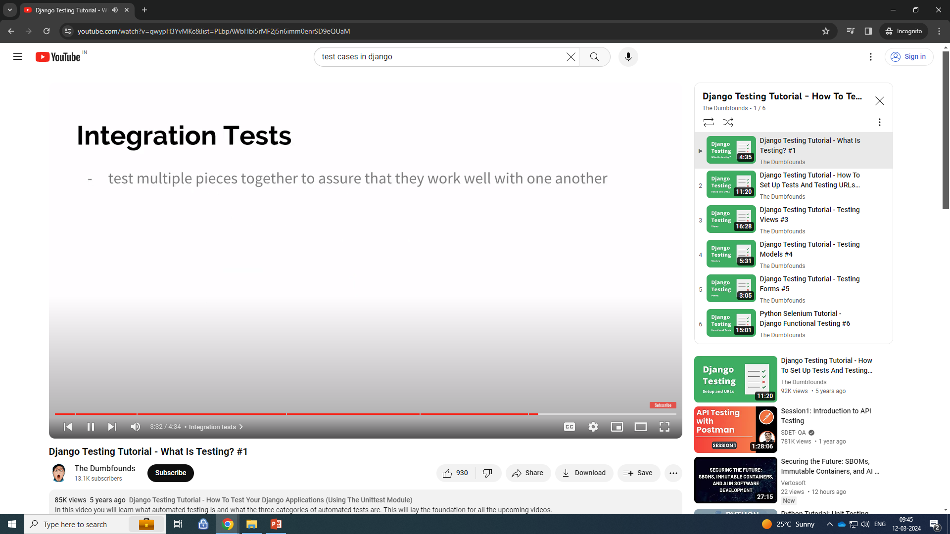

Slide 5
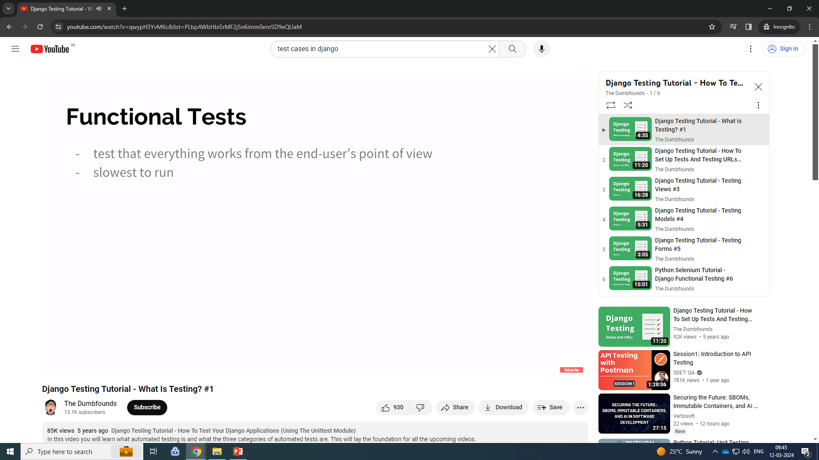

Slide 6
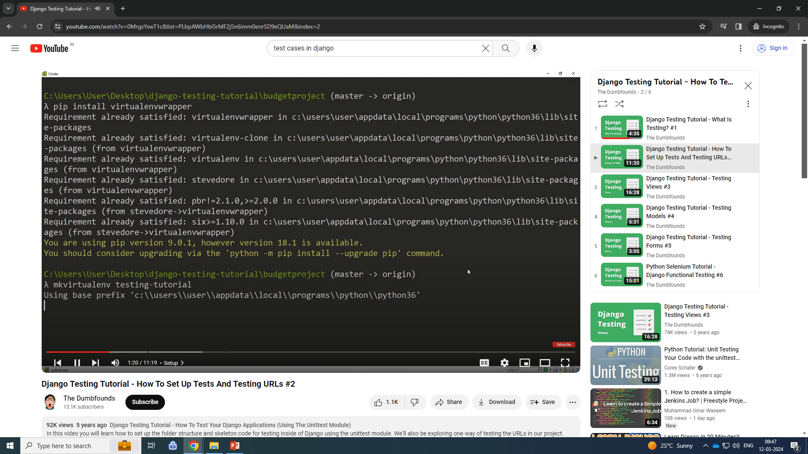

Slide 7
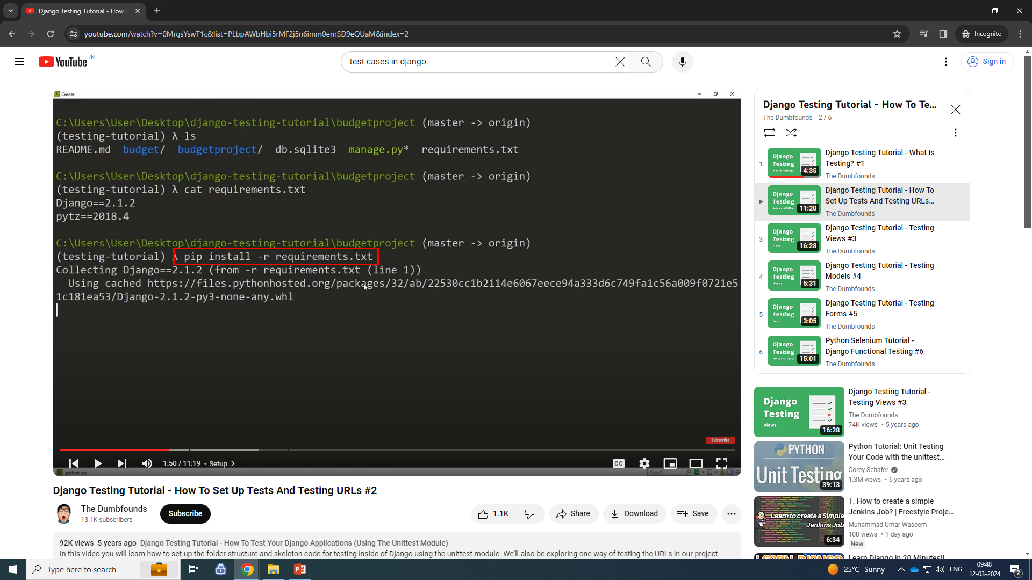

Slide 8
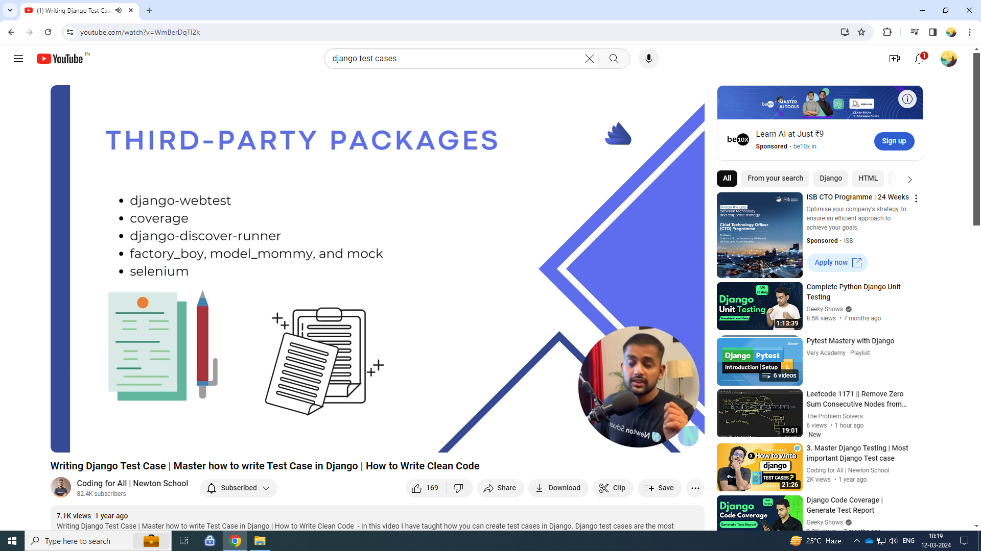
https://www.youtube.com/watch?v=WmBerDqTl2k

Slide 9
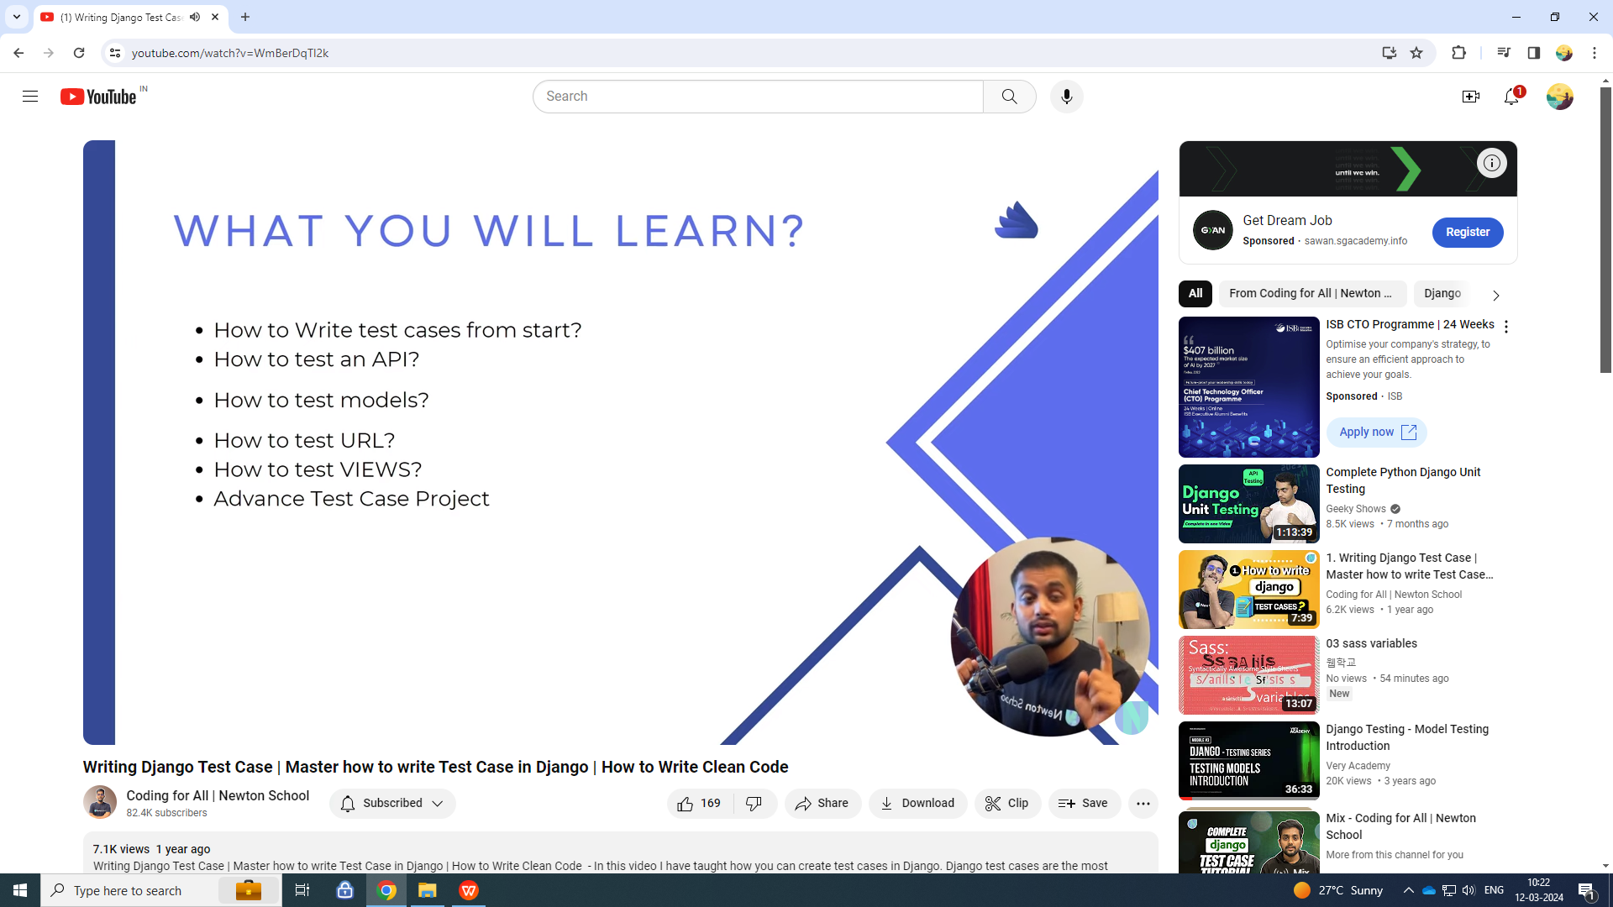

Slide 10
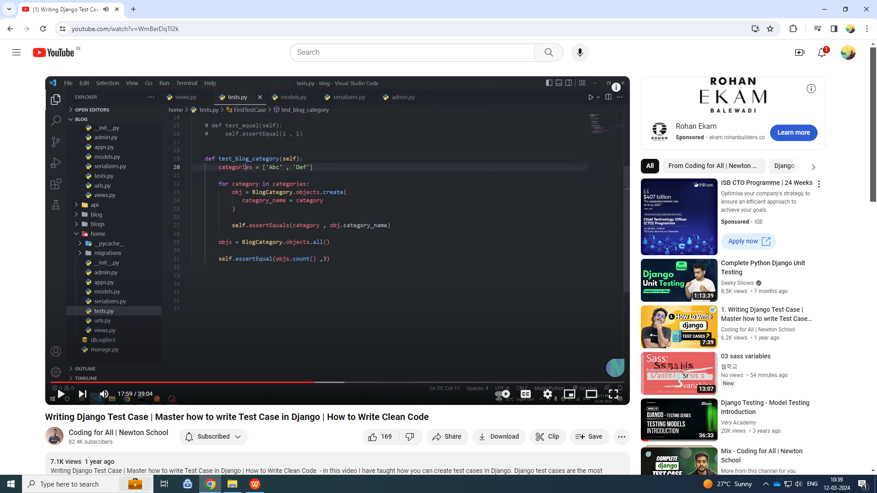
first test case

Slide 11
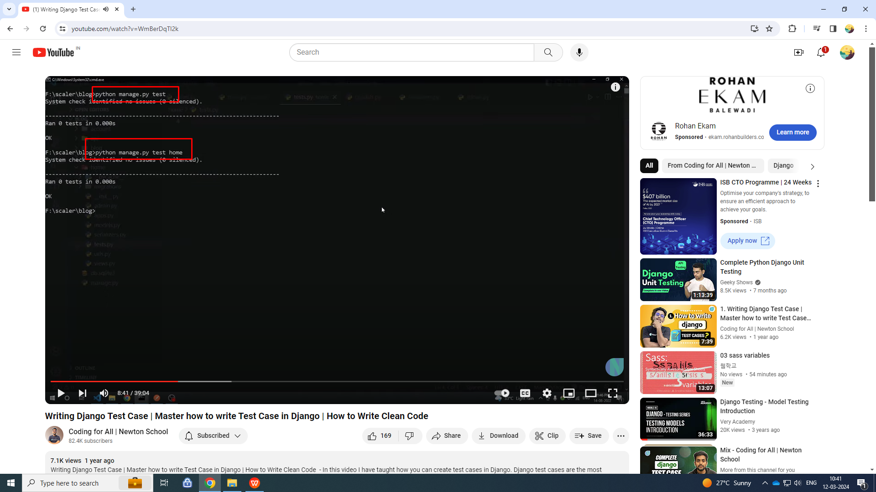
run test cases

Slide 12
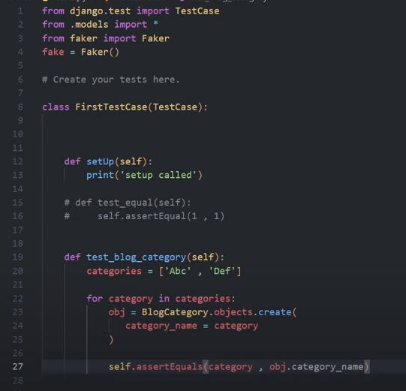

Slide 13
assertTrue,
from django.test import TestCase
from .models import *
class First_test_case(TestCase):
def setUp(self):
print("setup called")
def test_blog_ctr(self):
blog = ['firs', 'sends']
for blogs in blog:
# if len(blogs) <= 5:
obj = Blog.objects.create( title = blogs )
res = self.assertTrue(len( obj.title ) <= 5)

Slide 14
https://developer.mozilla.org/en-US/docs/Learn/Server-side/Django/Testing

Slide 15
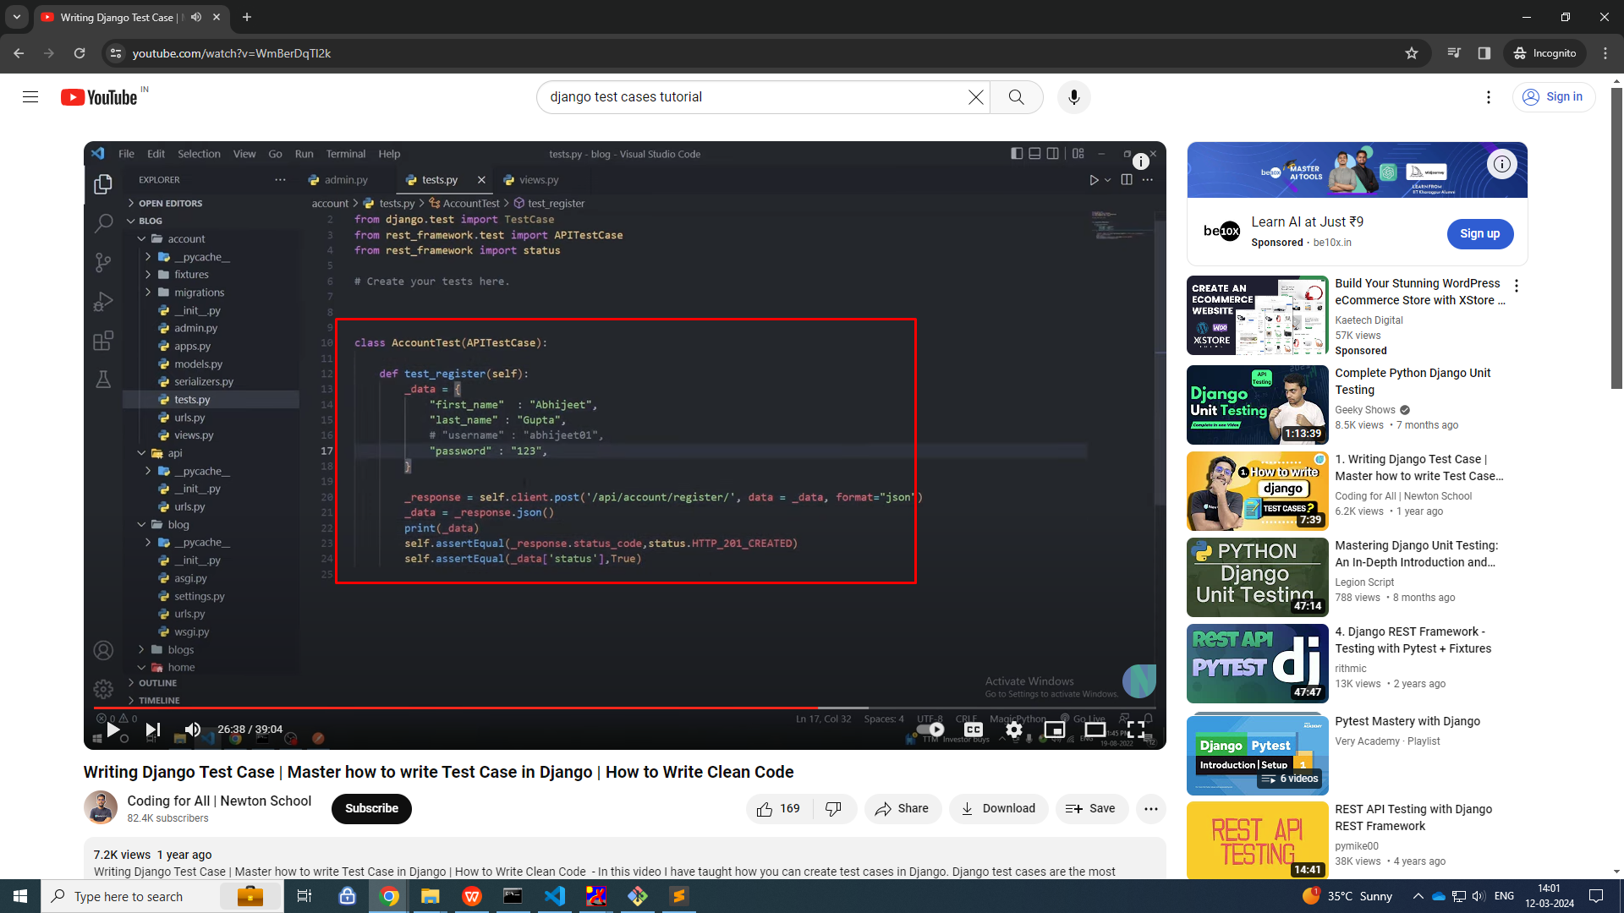
api test case

Slide 16
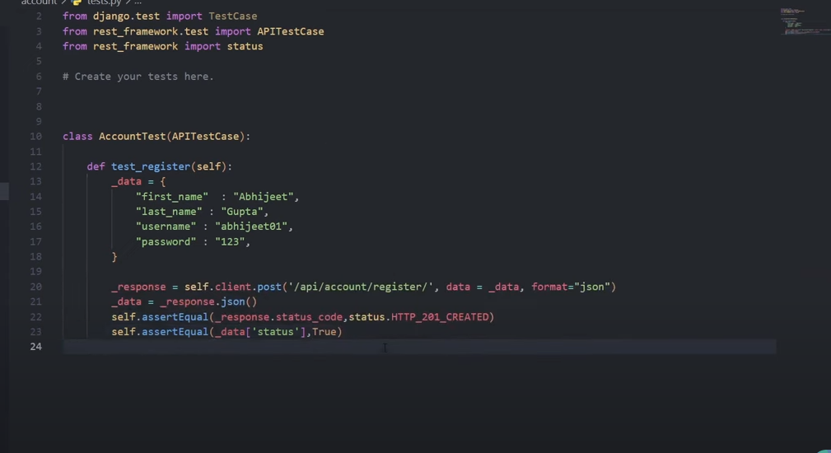

Slide 17
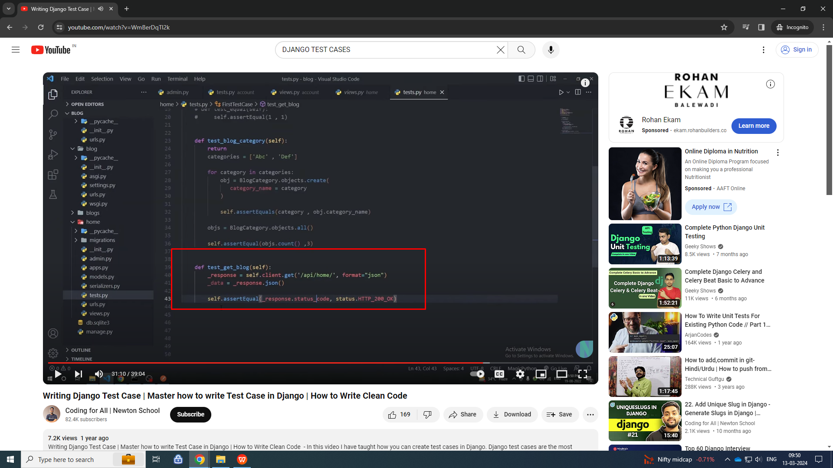

Slide 18
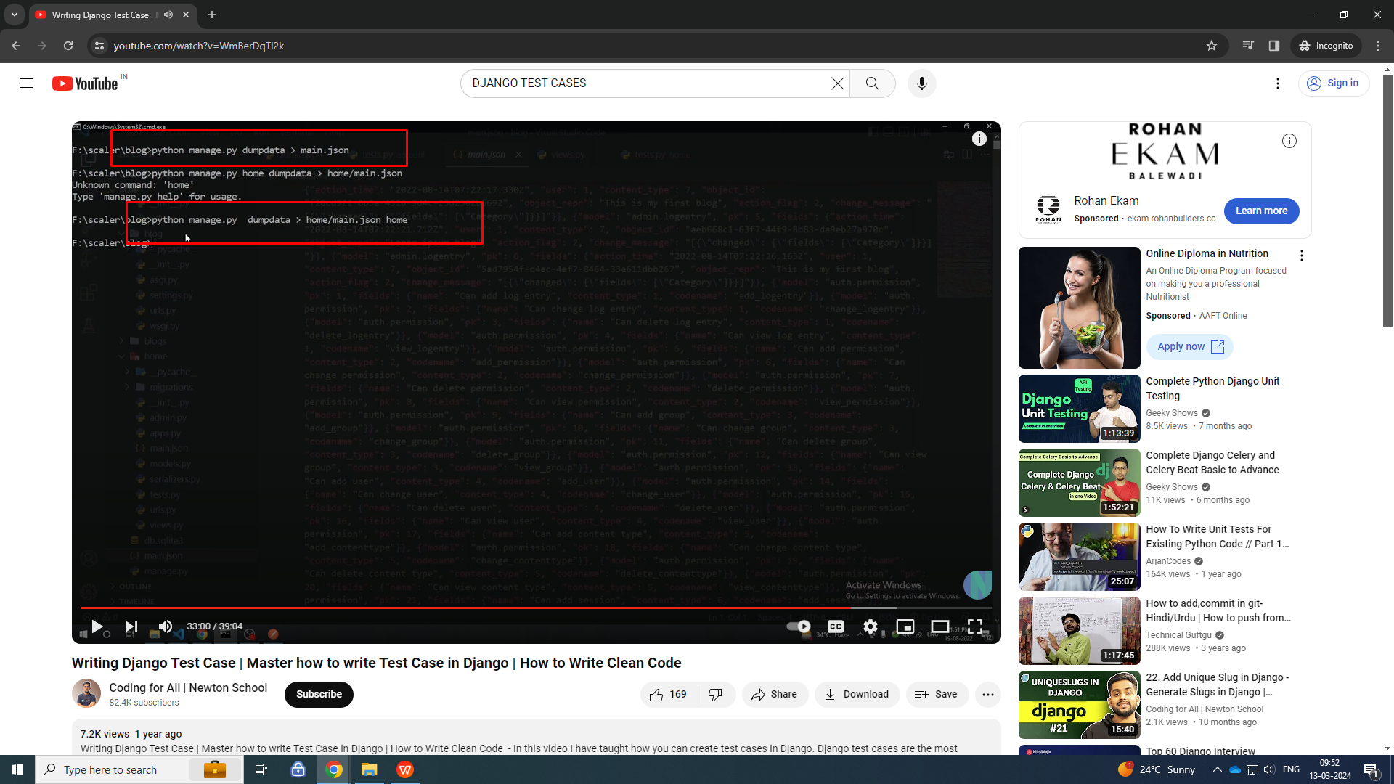
dump data in to file

Slide 19
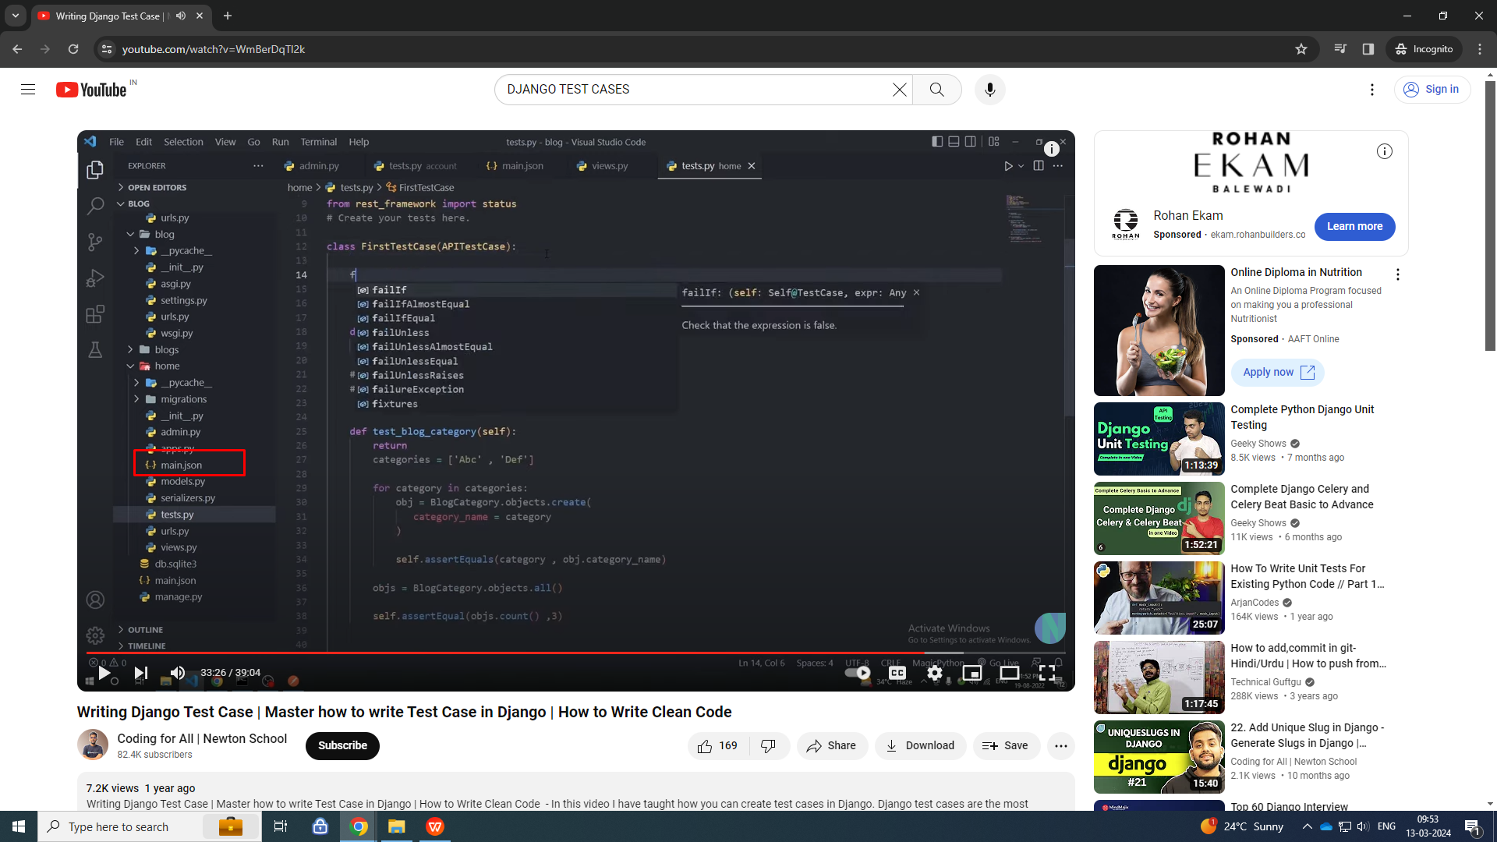

Slide 20
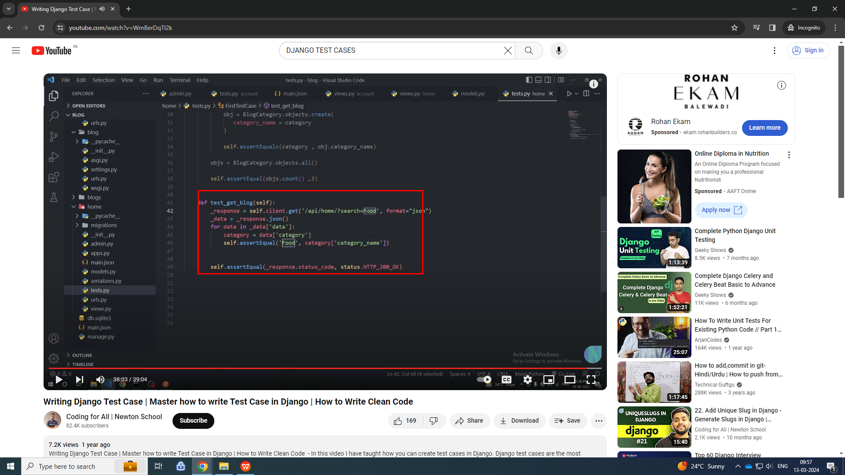

Slide 21
https://www.youtube.com/watch?v=f_xiy70g6_0

